Slide 1
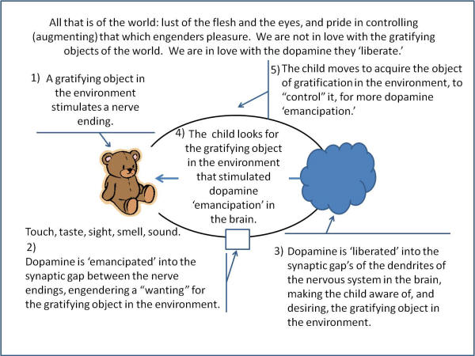
The Child’s Carnal Nature.
1. Love of pleasure, i.e., dopamine emancipation, which the world stimulates.
Hate of restraint, i.e., missing out on pleasure, which the world stimulates.
The child is not in love with the object itself,
the object being a person, place, or thing—imagined or real.
The child is in love with the dopamine emancipation which the object stimulates.

Slide 2
The Child’s Carnal Nature.
1. Love of pleasure, i.e., dopamine emancipation, which the world stimulates.
Hate of restraint, i.e., missing out on pleasure, which the world stimulates.
The child is not in love with the object itself,
the object being a person, place, or thing—imagined or real.
The child is in love with the dopamine emancipation which the object stimulates.

